Slide 1
ASP.NET Web API
Overview
Rahul Srivastava

Slide 2



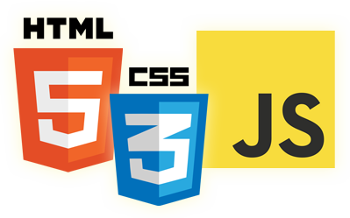
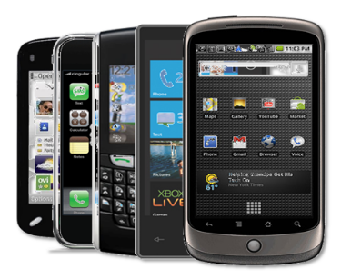
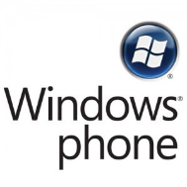


The Challenge
Notes:
OS
Screen Resolution
Deployment
Security
Browsers
Load Balance

Slide 3


Web Application (SPA)
Initial Request
Application.htm
RequireJS Loader
Application.js (bootstrap)
MVC4
Page1 Partial.htm
ViewModel (#index)
IndexViewModel.js
ViewModel (#login)
JSON Requests
Model (LoginModel)
Handling disconnection
HTML5 localstorage

Slide 4
Agenda
Why Services ?
Type of Services ?
What is REST ?
Features of REST
Web API Overview
SOAP vs. REST

Slide 5
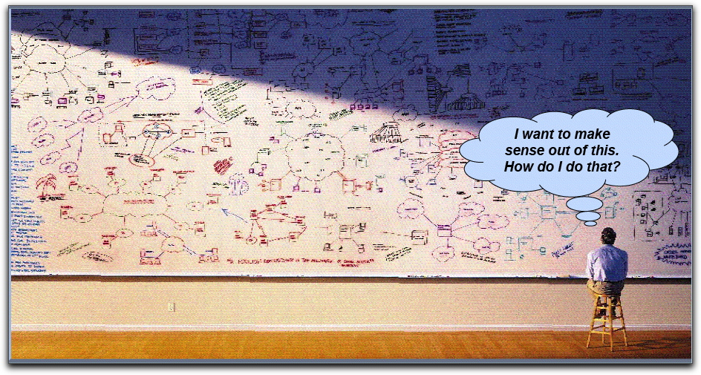
Why we need Services

Slide 6
Service & SOA
Service ?
A Service is a self-contained unit of software that performs a specific task.
A Service is a reusable component.
A Service changes business data from one state to another.
If you can describe a component in WSDL, it is a Service.
SOA is a software architecture model
in which business functionality are logically grouped and encapsulated into
self contained,
distinct and reusable units called services that
represent a high level business concept
can be distributed over a network
can be reused to create new business applications
contain contract with specification of the purpose, functionality, interfaces constraints, usage of the business functional

Slide 7
Type of Services
Big Web Services:
Big web services are based on SOAP standard and often contain a WSDL to describe the interface that the web service offers. The details of the contract may include messages, operations, bindings, and the location of the web service.
A- Address
B- Binding
C-Contract
REST Services:
RESTful web services are based on the way how web works. REST is neither a standard nor a protocol. It is just an architectural style like say for example client-server architecture. It’s based on HTTP.

Slide 8
What is REST
REST: Representational State Transfer
“REST is an architectural style not an protocol.”
The term representational state transfer was introduced and defined in year 2000 by Roy Fielding during his research in PhD programme. REST has been applied to describe desired web architecture, to identify existing problems, to compare alternative solutions and to ensure that protocol extensions would not violate the core constraints that make the web successful.

Slide 9
Resource Oriented Architecture (ROA)
An Entity, Item or just a thing you want to expose is a Resource
Resource-oriented architecture (ROA) is a style of software architecture
and programming paradigm for designing and developing software in
the form of resources with "RESTful" interfaces. These resources are
software components (discrete pieces of code and/or data structures)
which can be reused for different purposes.
Features of ROA:
Addressability: Addressable applications expose a URI for every
piece of information they might conceivably serve.
Statelessness : Statelessness means that every HTTP request happens in complete isolation. The server never relies on information from previous requests.
.
A uniform interface : Resource should be called using an HTTP Verbs (Get POST,PUT,DELETE)

Slide 10
Features of REST
Platform-independent (you don't care if the server is Unix, the client is a Mac, or anything else)
Language-independent (C# can talk to Java, etc.)
HTTP Based
Can easily be used in the presence of firewalls.
Limited bandwidth and resources
Totally stateless operations
Caching
Reach More Clients(Mobile , Tablet etc.)
Lightweight hosting and scalable with Cloud

Slide 11
ASP.net WEB API

Slide 12
ASP.NET Web API
ASP.Net Web API is a framework that makes it easy to build HTTP Services that reach a broad range of clients, including browsers and mobile devices. It's an ideal platform for building RESTFul Services on .Net Framework

Slide 13
Features of WEB API
Strong Support for URL Routing to produce clean URLs using familiar MVC style routing semantics
Content Negotiation based on Accept headers for request and response serialization
Support for a host of supported output formats including JSON, XML, ATOM
ODATA Support
Strong default support for REST semantics
Very extensible, based on MVC like extensibility model of Formatters and Filters
Self-hostable in non-Web applications
Testable using testing concepts similar to MVC

Slide 14
HTTP Verbs
GET
This is used to retrieve resource\resources.
POST
This is used to add new resource.
PUT
This is used to update resource.
DELETE
This is used to delete resource.

Slide 15
SOAP vs. REST

Slide 16
SOAP Features
Asynchronous processing and invocation;
Formal contracts;
Stateful operations
Supports Messaging Pattern

Slide 17
SOAP vs. REST
SOAP | REST
In SOAP along with data a lot of other meta data also needs to get transferred with each request and response. This makes the payload heavy even for small data | only the data will be traveling to and fro from the server because the capabilities of the service are mapped to the URIs and protocols
In SOAP there is need to create the proxy at client side. These proxies will do the marshaling and un-marshaling of SOAP WSDL and make the communication between the application and the web service possible. The problem with this proxy is that if the service is updated and the proxy on the client is not then the application might behave incorrectly | there is no need to have a proxy at the client end because its only data that is coming and the application can directly receive and process the data

Slide 18

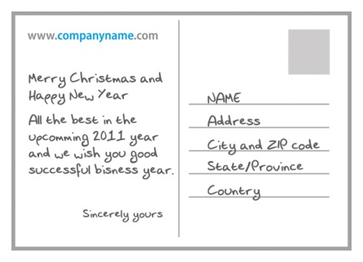


SOAP vs. REST

Slide 19
Usage
SOAP | REST
When designing an application of service oriented architecture which interconnects many systems and uses many transport channels, it is better to use SOAP. | When we plan to design an application to be used exclusively on the web, and also when we need a quick client integration.
Complex Applications which need different kind of bindings and protocols | Simple applications which major depends on CRUD operations.

Slide 20
ASP.Net Web API vs. WCF
Feature | ASP.Net Web API | WCF
Transport Channel | HTTP(s) | TCP, UDP, MSMQ, NamedPipes, HTTP(s), Custom
Protocol | HTTP | WS-*
Types | CLR Types | DataContract
Message Format | Text (xml, json) | SOAP+XML
Service Interface | HTTPMethod, URLPattern | Service Contract
State Management | Stateless | Stateless with Per Call
Cache | Built-n to HTTP Prefer application control | Handled by application
Error Handling | Exceptions, HTTP Status codes filters | Faults, Behaviors
Hosting | IIS, Self Host | IIS, Self Host
Client | IApiExplorer Shared Libraries | Proxy Class Shared Libraries

Slide 21
WCF REST Service vs. ASP.net Web API
WCF REST Service ASP.NET Web API
Service => Web API controller
Operation => Action
Service contract => n/a
Endpoint => n/a
URI Template => ASP.NET Routing
Message handlers => Same
Formatters => Same
Operation handlers => Filters, model binders

Slide 22
Disadvantage of REST
No Metadata
Only HTTP Security
Complexity kills

Slide 23
Thanks
Rahul Srivastava

